Slide 1
ROS – Publisher and Subscriber (C++)

Slide 2
cd ~/catkin_ws/src/beginner_tutorials/src
Create the src/talker.cpp file
#include "ros/ros.h"
#include "std_msgs/String.h"
#include <sstream>
int main(int argc, char **argv)
{
ros::init(argc, argv, "talker");
ros::NodeHandle n;
ros::Publisher chatter_pub = n.advertise<std_msgs::String>("chatter", 1000);
ros::Rate loop_rate(10);
int count = 0;
while (ros::ok())
{
std_msgs::String msg;
std::stringstream ss;
ss << "hello world " << count;
msg.data = ss.str();
ROS_INFO("%s", msg.data.c_str());
chatter_pub.publish(msg);
ros::spinOnce();
loop_rate.sleep();
++count;
}
return 0;
}

Slide 3
cd ~/catkin_ws/src/beginner_tutorials/src
src/listener.cpp
#include "ros/ros.h"
#include "std_msgs/String.h"
#include <sstream>
int main(int argc, char **argv)
{
ros::init(argc, argv, "talker");
ros::NodeHandle n;
ros::Publisher chatter_pub = n.advertise<std_msgs::String>("chatter", 1000);
ros::Rate loop_rate(10);
int count = 0;
while (ros::ok())
{
std_msgs::String msg;
std::stringstream ss;
ss << "hello world " << count;
msg.data = ss.str();
ROS_INFO("%s", msg.data.c_str());
chatter_pub.publish(msg);
ros::spinOnce();
loop_rate.sleep();
++count;
}
return 0;
}

Slide 4
CMakeLists.txt
rosed beginner_tutorials CMakeLists.txt
cmake_minimum_required(VERSION 2.8.3)
project(beginner_tutorials)
## Find catkin and any catkin packages
find_package(catkin REQUIRED COMPONENTS
roscpp
rospy
std_msgs
message_generation
)
## Declare ROS messages and services
add_message_files(DIRECTORY msg FILES Num.msg)
add_service_files(DIRECTORY srv FILES AddTwoInts.srv)
## Generate added messages and services
generate_messages(DEPENDENCIES std_msgs)
## Declare a catkin package
catkin_package(
CATKIN_DEPENDS message_runtime
)
include_directories(
${catkin_INCLUDE_DIRS}
)
## create two executables, talker and listener
add_executable(talker src/talker.cpp)
target_link_libraries(talker ${catkin_LIBRARIES})
add_dependencies(talker beginner_tutorials_generate_messages_cpp)
add_executable(listener src/listener.cpp)
target_link_libraries(listener ${catkin_LIBRARIES})
add_dependencies(listener beginner_tutorials_generate_messages_cpp)
catkin_make

Slide 5
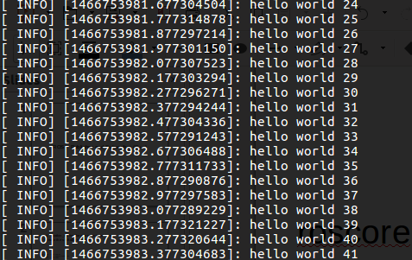
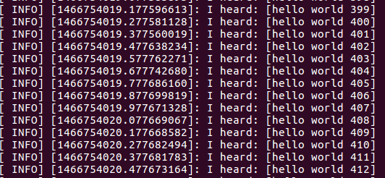
Rosrun
roscore
rosrun beginner_tutorials talker
rosrun beginner_tutorials listener

Slide 6
ROS – Service and Client (C++)

Slide 7
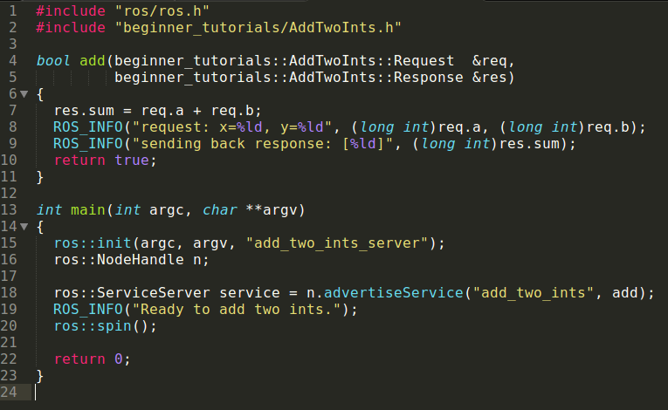
Create the src/add_two_ints_server.cpp

Slide 8
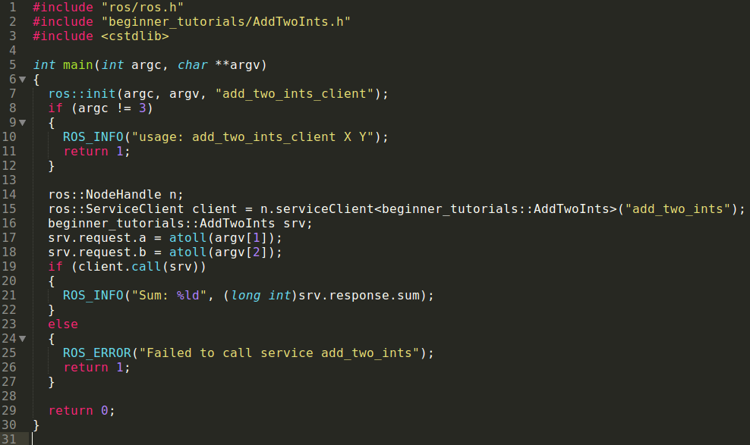
Create the src/add_two_ints_client.cpp

Slide 9
CMakeLists.txt
add_executable(add_two_ints_server src/add_two_ints_server.cpp)
target_link_libraries(add_two_ints_server ${catkin_LIBRARIES})
add_dependencies(add_two_ints_server beginner_tutorials_gencpp)
add_executable(add_two_ints_client src/add_two_ints_client.cpp)
target_link_libraries(add_two_ints_client ${catkin_LIBRARIES})
add_dependencies(add_two_ints_client beginner_tutorials_gencpp)

Slide 10
Run service and client
cd ~/catkin_ws
catkin_make
roscore
rosrun beginner_tutorials add_two_ints_server
rosrun beginner_tutorials add_two_ints_client 1 3

